Slide 1
Lecture 14 Boxplot
23/08/2022

Slide 2
Agenda
Boxplot,
Quantile–Quantile Plot,
Scatter Plots/Pair-plot and
its limitations

Slide 3
Box Plot

Slide 4
Box Plot
A boxplot, also known as a box-and-whisker plot, is a graphical representation of the distribution of a dataset.
It provides a visual summary of key statistics such as the median, quartiles, and potential outliers.
Boxplots are particularly useful for comparing the distribution of different datasets or for identifying the spread and central tendency of a single dataset

Slide 5
Boxplot Agenda
Importance of Box Plot
Components of a box plot
How to create a box plot
Interpretations from Box Plot

Slide 6
Why to use Box Plot?
Visualizing Data Distribution: Boxplots provide a clear summary of the distribution of a dataset, showing key statistics like the median, quartiles, and potential outliers. They help you understand the spread and central tendency of your data.
Comparing Distributions: Boxplots are great for comparing the distributions of multiple datasets side by side. This is particularly useful when you want to compare variables or groups in a dataset, such as comparing the salary distributions of different job roles.

Slide 7
Why to use Box Plot
Identifying Outliers: Boxplots can help identify potential outliers in your data. Values falling outside the "whiskers" (1.5 times the interquartile range) are often considered as potential outliers.

Slide 8
Why to use Box Plot?
Assessing Skewness: Boxplots can provide insights into the skewness of a dataset. If one whisker is much longer than the other, it suggests that the data might be skewed in that direction.
Understanding Spread: Boxplots show the interquartile range (IQR), which represents the middle 50% of the data. Comparing IQRs across different groups can reveal differences in data variability.
Data Quality Assessment: Boxplots can help identify data quality issues such as data entry errors or measurement inconsistencies. Outliers or unusual patterns in the data might indicate errors.

Slide 9
Why to use Box Plot?
Detecting Changes Over Time: Boxplots can be used to visualize changes in data distributions over time or between different conditions. This can help identify shifts or trends in the data.
Exploratory Data Analysis: Boxplots are often used in exploratory data analysis to quickly understand the characteristics of a dataset before diving into more detailed analyses.

Slide 10
Why to use Box Plot?
Communication of Results: Boxplots are easy to understand even for audiences with limited statistical knowledge. They can be used to present summary statistics and key features of the data in a visually appealing manner.
Decision Making: Boxplots can aid in decision-making processes, such as comparing the performance of different products, analyzing customer feedback scores, or assessing the impact of changes in a process

Slide 11
Components of a Box Plot
Minimum – It is the minimum value in the dataset excluding the outliers
First Quartile (Q1) – 25% of the data lies below the First (lower) Quartile.
Median (Q2) – It is the mid-point of the dataset. Half of the values lie below it and half above.
Third Quartile (Q3) – 75% of the data lies below the Third (Upper) Quartile.
Maximum – It is the maximum value in the dataset excluding the outliers.

Slide 12
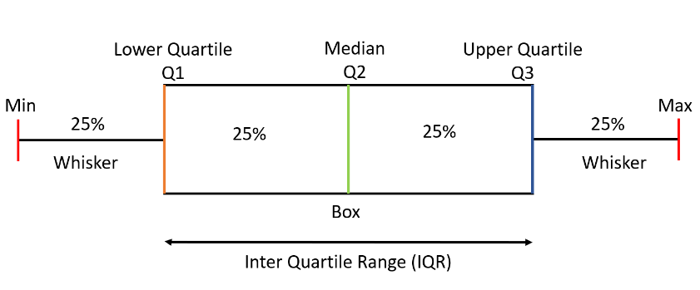
BOX PLOT COMPONENT

Slide 13
Inter Quartile Range
The area inside the box (50% of the data) is known as the Inter Quartile Range.
The IQR is calculated as –
IQR = Q3 - Q1

Slide 14
Outliers
Values that fall below
Q1 - 1.5 * IQR
Q3 + 1.5 * IQR.

Slide 15
How to create a box plot?
Collect Data: First, you need a dataset that you want to visualize using a boxplot.
Calculate components-Q1,Q2,Q3,IQR,Outlier
Draw Boxplot

Slide 16
Draw Boxplot
Draw a rectangular box from Q1 to Q3.
Draw a vertical line inside the box to represent the median (Q2).
Draw "whiskers" (lines extending from the box) from Q1 to the minimum value within
Q1 - 1.5 * IQR, and from Q3 to the maximum value within Q3 + 1.5 * IQR.
Represent potential outliers as individual data points outside the whiskers.

Slide 17
Example
The runs scored by a cricket team in a league of 12 matches –
100,120,110,150,110,140,130,170,120,220,140,110
Draw whisker plot(Box Plot )for given data?

Slide 18
Step to Draw Box Plot
Ascending Order –
100,110,110,110,120,120,130,140,140,150,170,220
2. Median (Q2) = (120+130)/2 = 125
3. Q1 = (110+110)/2 = 110
4. Q3 = (140+150)/2 = 145
5. IQR = Q3-Q1 = 145-110 = 35
6. Lower Limit = Q1-1.5*IQR = 110-1.5*35 = 57.5
Upper Limit = Q3+1.5*IQR = 145+1.5*35 = 197.5
7. Minimum = 100 Maximum = 170
8. Outliers = 220

Slide 19
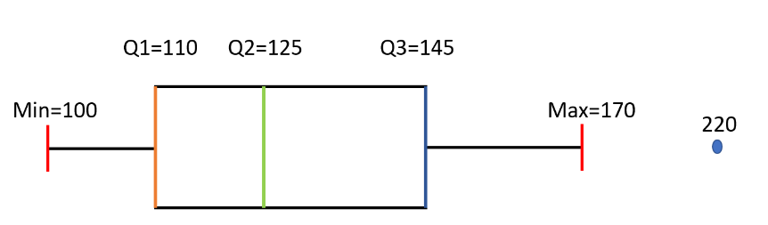
Draw Boxplot for Example

Slide 20
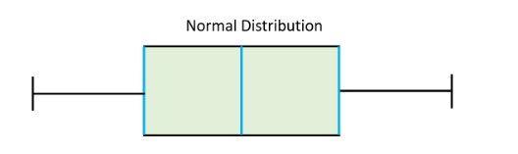
Interpretation of Box Plot
Box Plot- Normally Distributed
If the Median is at the center of the Box and the whiskers are almost the same on both the ends then the data is Normally Distributed.

Slide 21
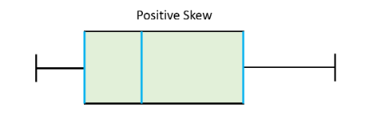
Box Plot-Positive Skew
If the Median lies closer to the First Quartile and if the whisker at the lower end is shorter (as in the above example) then it has a Positive Skew (Right Skew).

Slide 22
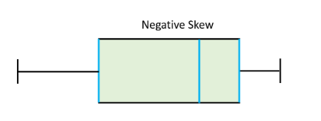
Box Plot-Negative Skew
If the Median lies closer to the Third Quartile and if the whisker at the upper end is shorter then it has a Negative Skew (Left Skew).

Slide 23
Interpretation of Skew for given example
We were create a histogram or a boxplot of the dataset, we would see that the distribution is right-skewed, with most runs scored in cricket clustered on the left side and a few higher runs extending the right tail.
This example illustrates how a positive skewness can occur in a cricket runs dataset, where most cricketers earn average or below-average runs, but a few cricketer(player) earn significantly higher runs, causing the distribution to be right-skewed.

Slide 24
Limitation of Box plot
Sensitivity to Data Size:
Box plots might not be as informative when dealing with small datasets. With a small number of data points, the representation of the distribution might not accurately capture the underlying characteristics.
Doesn't Show Exact Data Distribution:
While box plots show key summary statistics like quartiles and potential outliers, they don't provide a detailed view of the shape of the distribution like a histogram or density plot does.

Slide 25
Limitation of Box plot
Potential Overpotting:
In dense regions of the plot, data points might overlap and lead to overplotting, making it challenging to distinguish individual points and their density.
Lack of Granularity:
Box plots provide a general overview of the data distribution, but they might lack the granularity needed to reveal finer details or subtle patterns.

Slide 26
Limitation of Box plot
Doesn't Indicate Sample Size:
Box plots don't indicate the actual sample size of each group or category being compared, potentially leading to misinterpretation of the distribution's reliability.
Handling Multiple Modes:
Box plots are less effective at visualizing multimodal distributions (distributions with multiple peaks) or complex shapes.
Limited for Categorical Data:
While box plots are ideal for continuous data, they might not be as effective for visualizing the distribution of categorical data.

Slide 27
Limitation of Box Plot
Ignoring Data Points:
Box plots might not convey the full data distribution when data points fall outside the whiskers. The actual values of these points are often ignored in the plot.
Not Suitable for Time-Series Data:
Box plots might not be the best choice for representing time-series data or data with a temporal component since they don't capture temporal relationships.

Slide 28
Limitation of Box Plot
Skewed Data Misinterpretation:
In the presence of skewed data, interpreting the relationship between quartiles and the whiskers can be misleading.
Comparing Variability Across Groups:
While box plots give a sense of variability, comparing the variability between groups can sometimes be challenging.

Slide 29
Thank you!!!!

